Slide 1




NEWS DATA ANALYSIS
TEAM 8

Slide 2





SURYA TEJA REDDY
ML ENGINEER
TEAM MEMBERS
RAMYA
DATA ENGINEER
PAVAN REDDY
CLOUD ENGINEER
JAHNAVI
BUSINESS ANALYST

Slide 3
OBJECTIVE
The objective of this project is to design and implement a comprehensive end-to-end data pipeline on AWS for news data. This pipeline will automate the extraction, preprocessing, and analysis of news data from various sources using machine learning techniques such as topic modeling, sentiment analysis, and predictive modeling. The primary goal is to deliver a scalable and efficient solution with actionable insights derived from news data analysis, enabling informed decision-making and strategic planning processes.

Slide 4

BUSINESS QUESTIONS

Slide 5
BUSINESS QUESTIONS
What are the current trending topics in the news, and how do they vary across different sources?
What are the primary topics or themes covered in the news, and how do they evolve over
time?
What are concise and informative summaries of news articles?

Slide 6

DATA MINING AND ANLAYSIS
Notes:
Data mining and analysis

Slide 7
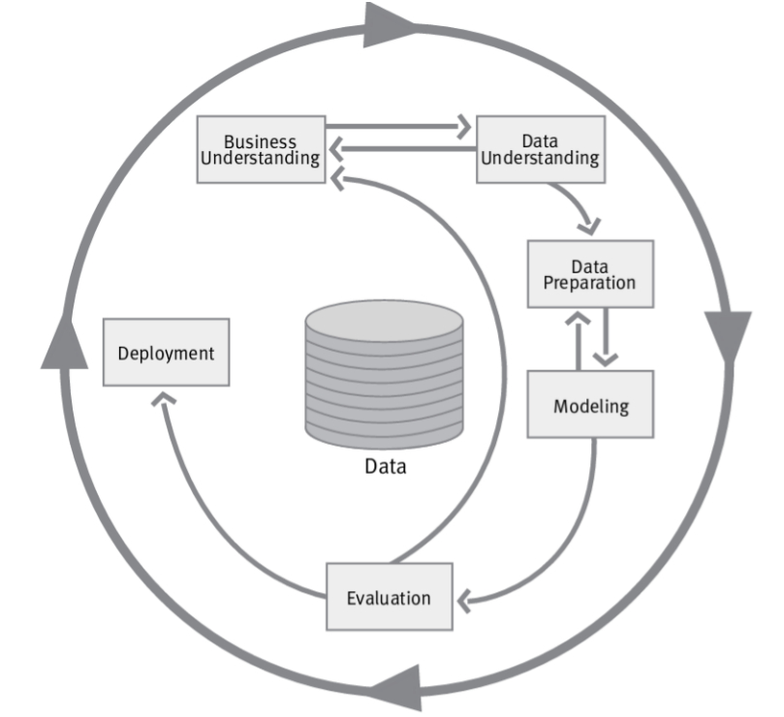
CRISP-DM

Slide 8

Business Understanding:
Goal: Automate news data extraction and analysis on AWS.
Purpose: Enhance decision-making and strategic planning.
Data Understanding:
Assess news data from various sources.
Understand structure, quality, and relevance.
Data Preparation:
Clean, preprocess, and integrate news data.
Tasks: Text parsing, normalization, feature engineering.
Modeling:
Apply techniques like topic modeling, sentiment analysis.
Derive insights from prepared news data.
Evaluation:
Assess model performance and insights quality.
Ensure alignment with project objectives.
Deployment:
Put analysis into action on AWS.
Setup automated extraction and analysis pipeline.

Slide 9

Proposed solution

Slide 10
Gathering Data
Refining Data
Exploratory Data Analysis
Data Modelling
Model Evaluation
Deployment

Slide 11



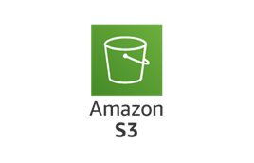



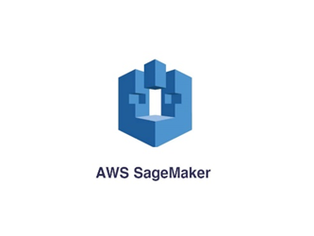

Data Extraction
Data Preprocessing
Trigger
Model Evaluation and Deployment

Slide 12


DATA EXTRACTION
The data for our project is sourced from the News API, an extensive and constantly updated news aggregation service.
Our approach involves extracting data from this API using Python and storing it in Amazon S3.
To automate this extraction process daily, we'll leverage AWS Glue to create a job and schedule it using CloudWatch triggers.
This ensures a streamlined and efficient workflow for maintaining up-to-date news data for our analysis.

Slide 13
Data Storage and Processing
We will set up an AWS Redshift instance.
Leveraging an AWS Glue Job, we'll automate the process of loading and updating data from S3 into corresponding tables within Redshift.
This streamlined approach ensures efficient data processing tailored to meet the requirements of our subsequent analyses.

Slide 14
DATA MODELING
We'll leverage AWS Sage Maker to develop and train machine learning models on our preprocessed data stored in Amazon Redshift.
Using Sage Maker, we'll explore various modeling techniques and algorithms suitable for our analysis objectives, such as topic modeling or sentiment analysis.
Additionally, we'll conduct Exploratory Data Analysis (EDA) to gain deeper insights into the characteristics and patterns within our data.

Slide 15
MODEL EVALUATION
We use Amazon Sage Maker’s tools to rigorously assess our trained machine learning models.
Deployed to Sage Maker endpoints, we evaluate their performance using validation datasets and diverse metrics like accuracy, precision, recall, and F1-score for classification, or mean absolute error and root mean squared error for regression.

Slide 16
MODEL DEPLOYMENT
We utilize Amazon Sage Maker’s seamless deployment capabilities to transition our trained machine learning models into production-ready environments.
Leveraging Sage Maker endpoints, we make the models accessible for real-time inference, enabling seamless integration into existing systems and applications.

Slide 17
Git Hub Link:
RamyaBoggalaRamesh/DSCI-60007-04-DSDE-TermProject-Team8 (github.com)

Slide 18

THANK YOU

